Slide 1

林大衛 104590050
羅允宣 105590048
陳福國 105590051

Slide 2

Introduction and Motivation
We created a pizzeria webpage. Our pizzeria is called Slice. The main product of our pizzeria is obviously
pizza, but we will also be selling other products such as soups, salads, and desserts.
We decided to create a pizzeria since we really enjoy Italian food. We also wanted to create something that a
lot of people enjoy, so we thought a pizzeria wouldn’t
be a bad idea.

Slide 3
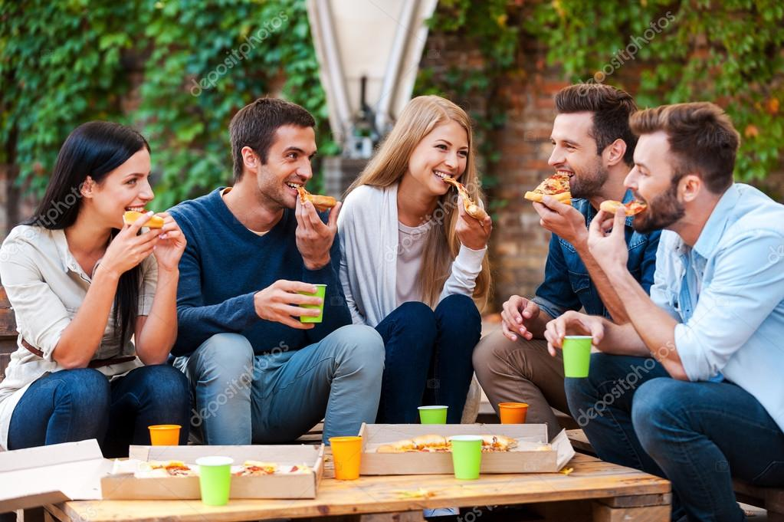
Target
There are people of all ages who love to eat pizza, but the main
consumers are mostly teenagers and young adults. Therefore, we
have designed our menu to attract these
type of consumers.

Slide 4
Features
Our webpage will let the user change the content’s language, create an account, get in contact with the pizzeria, and make online orders either for delivery or carryout.

Slide 5
What problems do we solve?
Our webpage will have the functionality of letting the user order online. If the user chooses to order for carryout, he can simply make the order online, pass by our pizzeria when the order is ready, and go home, he won’t waste any time in queue or waiting in the restaurant. If he chooses to order for delivery, he can simply relax in his couch and wait for the food to arrive.

Slide 6
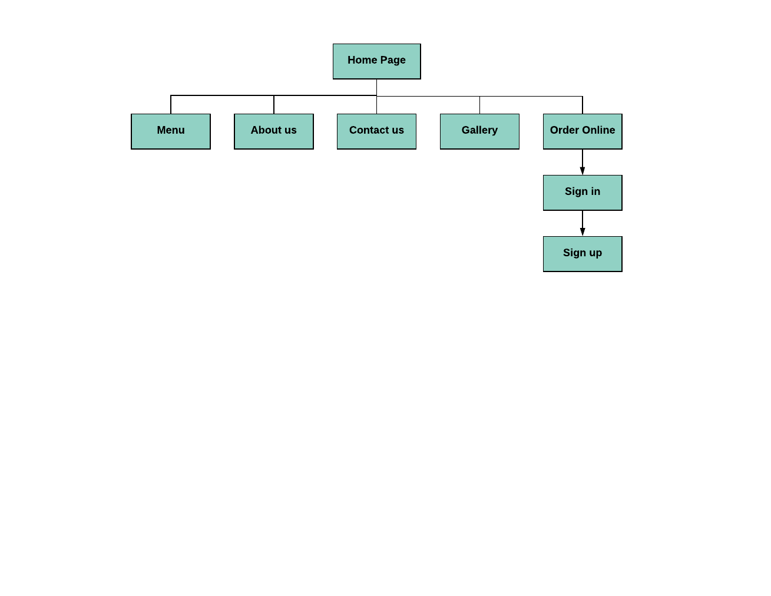
Web Page Structure

Slide 7
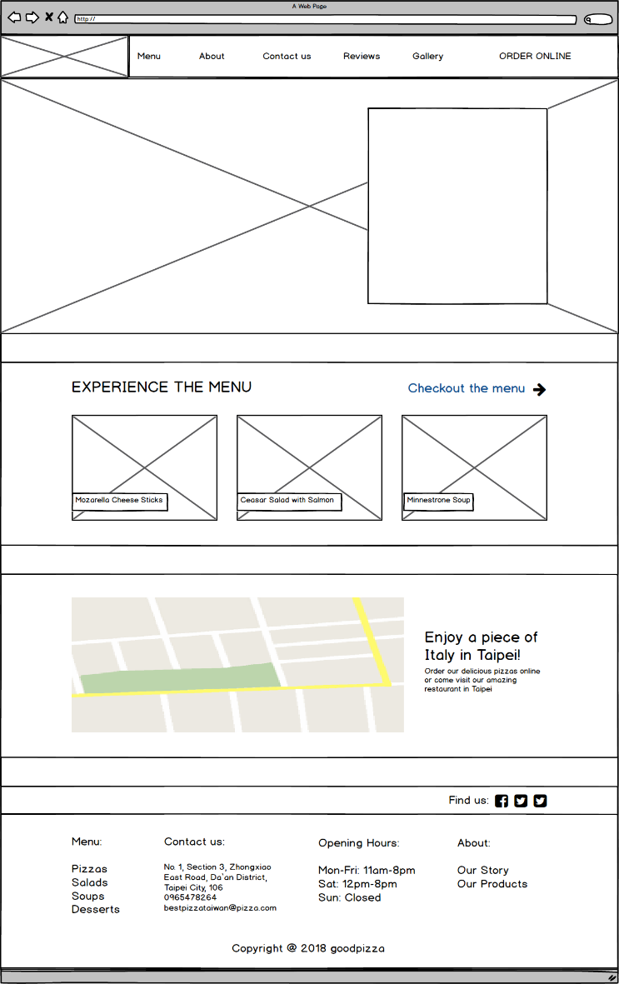
Header
Header Image
Menu Preview
Map
Footer

Slide 8
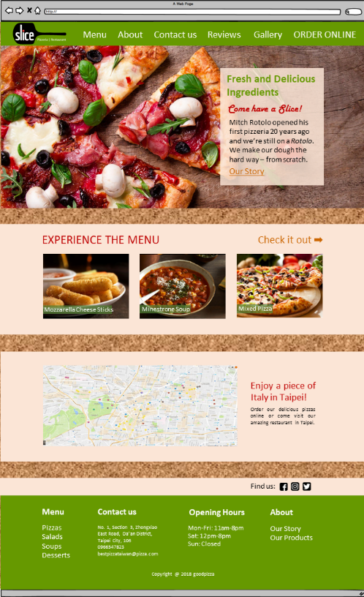

Slide 9
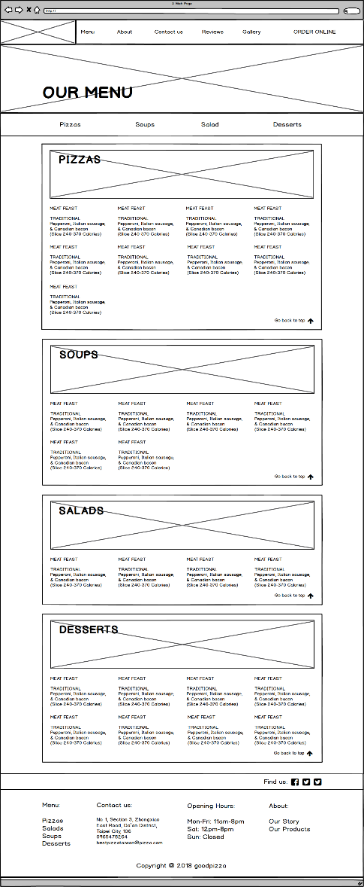
Header
Menu navbar
Menu items
Footer

Slide 10
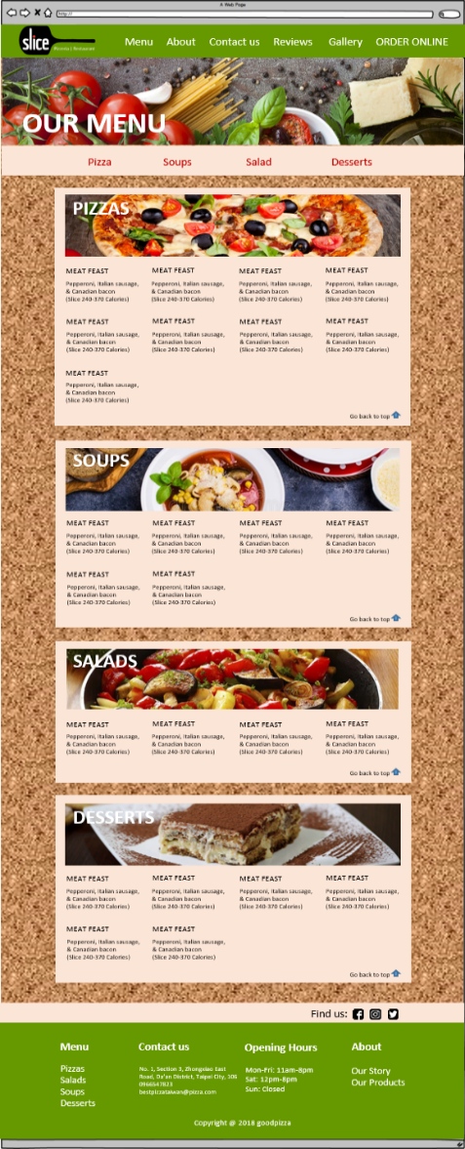

Slide 11
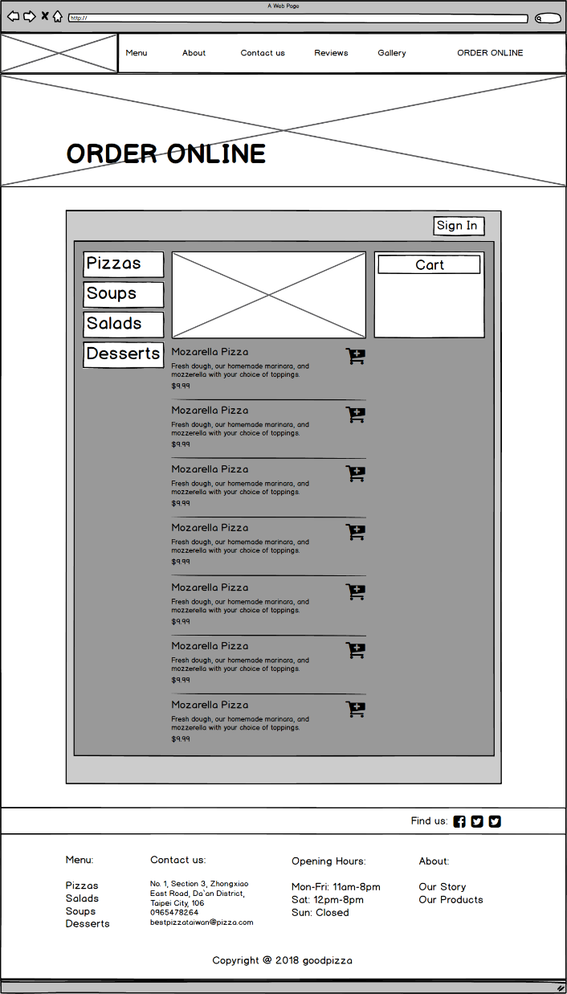
Navbar
Sign in button
Item navbar
Shopping Cart
Items
Footer

Slide 12
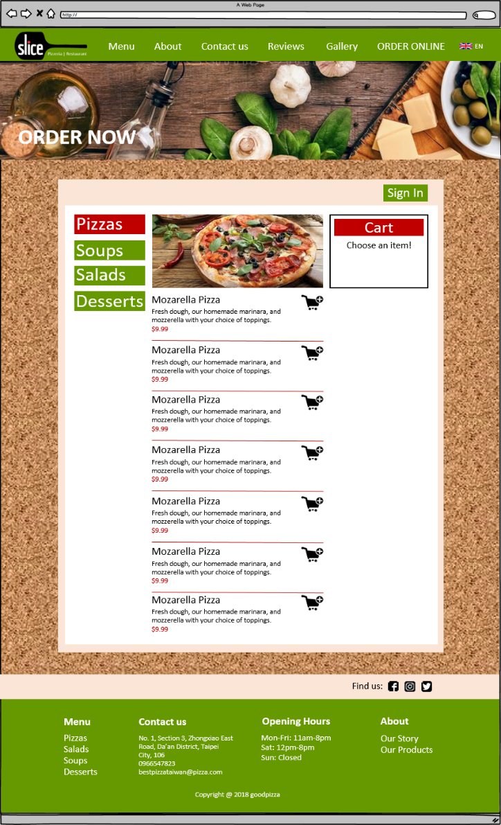

Slide 13
Thank You!

